Slide 1
Vertical Farming
Bryan Morrison

Slide 2
Overview
Slide 1: Home Page
Slide 2: Overview
Slide 3: History
Slide 4: Plan and Implementation
Slide 5: Pros
Slide 6: Cons
Slide 7: Summary
Slide 8: References

Slide 3
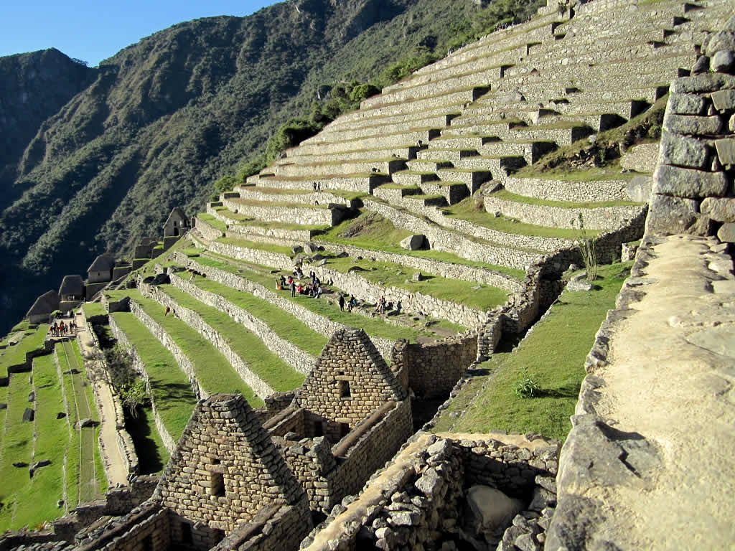
History
The term has been around for a long time.
People in South America with limited farming space used plateaus to farm also called vertical Farming.
Old idea that can put used in a new way using modern technologies
Idea is being tested in countries like South Korea to see if it is
Notes:
Indigenous people in South America have long used vertically layered growing techniques, and the rice terraces of East Asia follow a similar principle. But, now, a rapidly growing global population and increasingly limited resources are making the technique more attractive than ever.

Slide 4
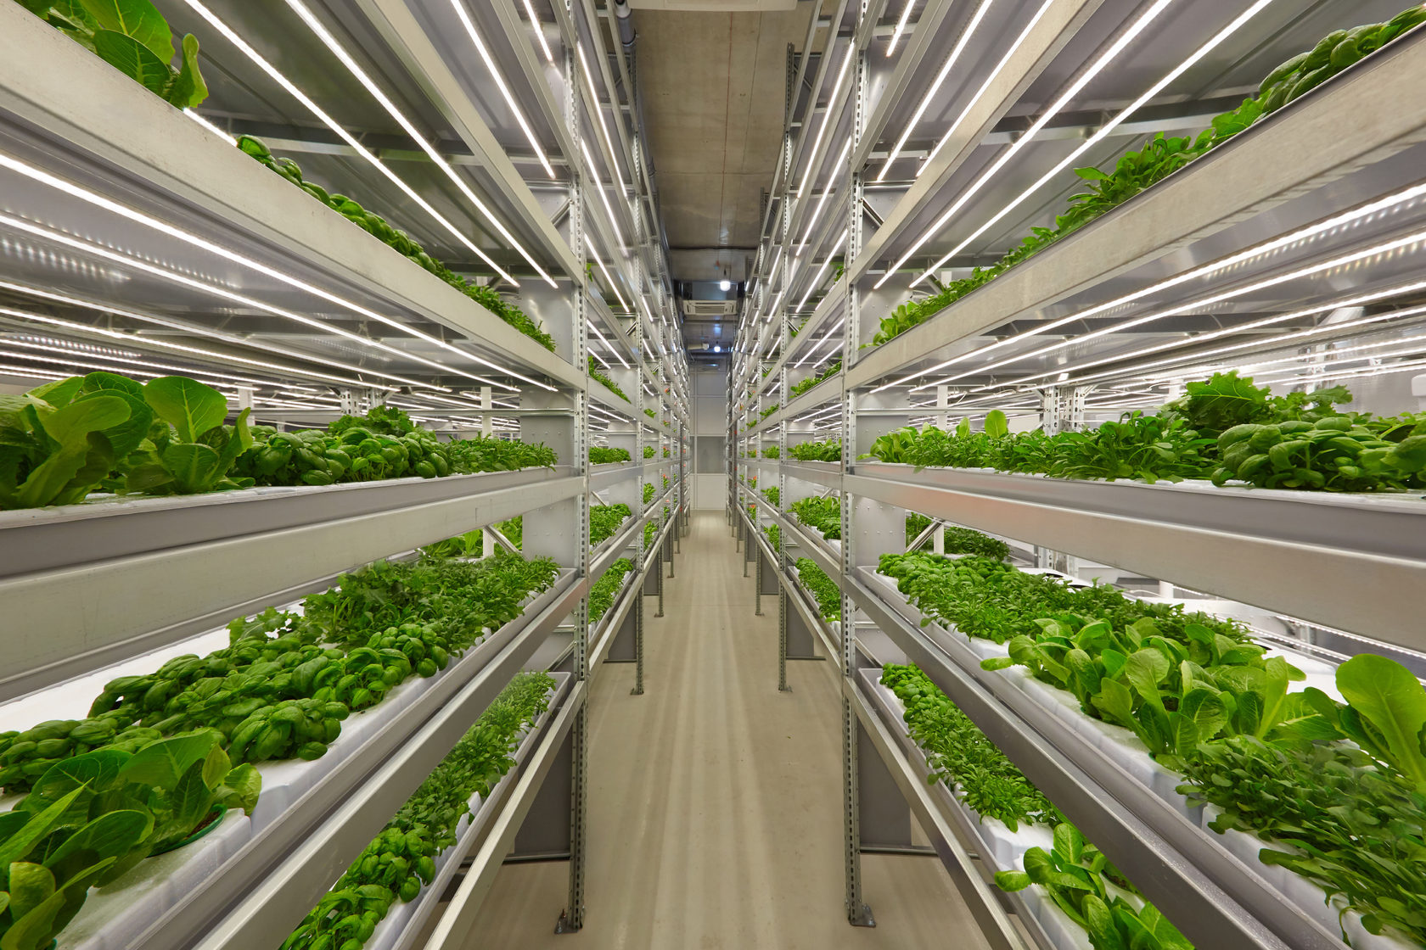
Plan and Implementation
Impact the price of food.
The Travel distance of food to Grocery Stores.
Be able to grow food in cities.
Have food that is community grown.

Slide 5
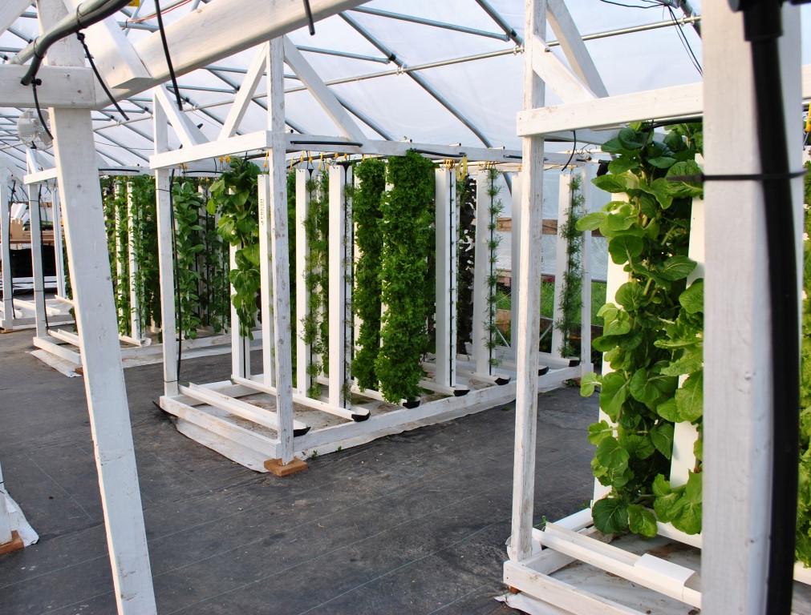
Upsides/Pros to the Advancement
No use of pesticides.
Builds up so not as much ground is needed.
Food can be grown locally (fresher food).
Can control condition so the plants grow more efficiently.

Slide 6
Downsides/Cons to the Advancement
$
Has to be built up
Uses LED to grow, so needs grower.
Not cost efficient
Increase food production in local areas
Can’t grow some crops as well.
$
$

Slide 7
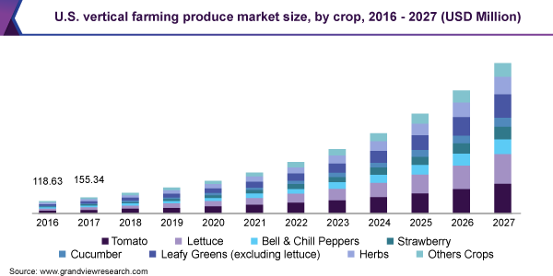
Summary
That Vertical farming is a good base idea that can be done, but for it to be worth doing it needs to become more energy efficient and affordable. Right not the land saved in vertical farming is not worth the cost of it, but maybe one day it will be.

Slide 8
References
Slide 3-4
Slide 5
Slide 6
Slide 7 Graph

